Slide 1

Point Cloud Technology

Slide 2
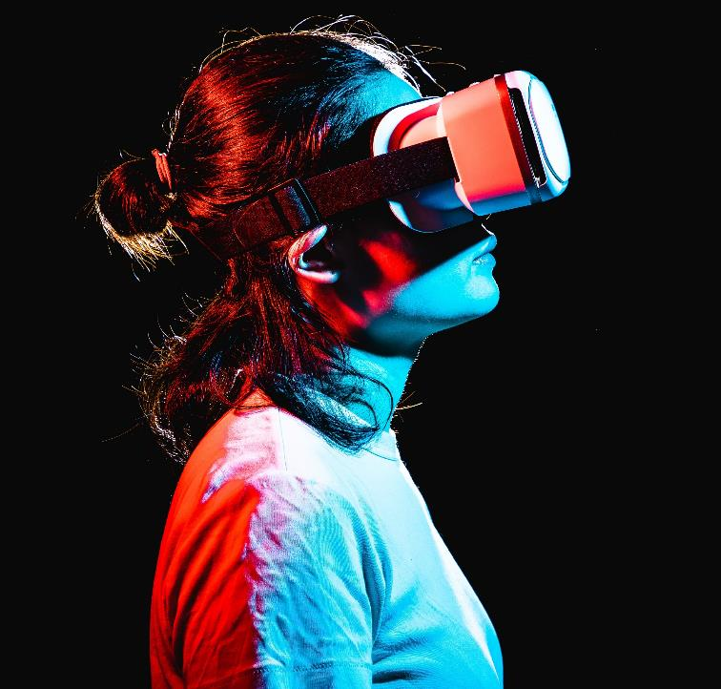
Group Members
Name:Alamin Sheikh Naim Name: Muhaiminul Hasan Dihan
ID:2013556642 ID:2111208642
Name:Tawhid Islam Name:Ahmed Sadman
ID:2021499042 ID:2014094046

Slide 3

Introduction
Point cloud systems digitize the physical world by capturing millions of precise spatial data points, forming 3D models of objects or environments. Generated by technologies like LiDAR and 3D scanning, they revolutionize industries from autonomous driving to architecture. These dense data clusters unlock unparalleled accuracy, enabling visualization, analysis, and innovation in recreating and interacting with our world digitally.
​

Slide 4




Applications in Industries
Architecture & Construction
Automotive and Aerospace
Gaming and Film
Healthcare
Point clouds in architecture and construction are used for precise 3D modeling, creating accurate as-built documentation, aiding in design and renovation projects, enabling virtual walkthroughs, improving structural analysis, and enhancing collaboration through real-time data integration and visualization.
In automotive and aerospace, point clouds enable precise 3D scanning for design, prototyping, reverse engineering, quality control, and inspection, enhancing production accuracy, reducing errors, and optimizing component integration and performance testing.
Gaming and film use immersive 3D environments for VR and CGI, delivering realistic visuals, interactive worlds, and lifelike animations. These technologies redefine storytelling, enabling audiences to engage with unparalleled depth and realism.
Point cloud systems in healthcare enable precise 3D models of organs, tissues, and facilities. They aid in diagnosis, surgical planning, custom prosthetics, robotic surgeries, and physical therapy. This technology enhances precision, customization, and innovation for better patient care.

Slide 5
Key Benefits of Point Cloud
High Precision: They capture millions of accurate data points, crucial for applications like surgical planning, diagnostics, or construction modeling.
Efficiency: Automate complex tasks like site surveys or 3D modeling, saving time and improving productivity in industries like construction and design.
Versatility: Used across healthcare, automotive, and entertainment industries for applications like robotic surgeries, autonomous navigation, and immersive virtual environments.

Slide 6
Improved Collaboration
Shared 3D Models: Point clouds provide detailed, sharable 3D models, allowing teams to work on the same data remotely. This improves understanding and coordination across disciplines like architecture, construction, and healthcare.
Cross-Disciplinary Integration: Point cloud data integrates seamlessly with GIS, CAD, and BIM systems, enabling collaboration between designers, engineers, and planners on a single platform.
Real-Time Updates: Cloud-based point cloud platforms enable real-time sharing of updates, ensuring all stakeholders are aligned with the latest project developments.
Enhanced Communication: Visual, data-rich 3D models improve communication, reducing misunderstandings and enabling informed decision-making among teams.

Slide 7
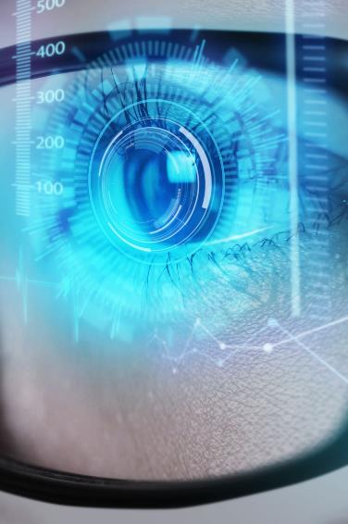
Real-Time Data Visualization
Instant Analysis: Real-time visualization allows immediate inspection and analysis of point cloud data, helping identify issues or opportunities without delay.
Interactive Exploration: Users can navigate and interact with 3D models in real-time, making it easier to understand complex environments or structures.
Collaborative Decision-Making: Teams can view and discuss updated data instantly, improving communication and decision-making across various industries, like construction or healthcare.
Enhanced Accuracy: Real-time data helps spot errors or inconsistencies quickly, ensuring more accurate results and minimizing the risk of costly mistakes in projects.

Slide 8

Point cloud Model
​
PointCNN
PointNet
PointNet++
KCNet
SO-Net
DeepSets
DGCNN

Slide 9
Enhanced Accuracy and Detail
Point Cloud Upsampling and Denoising:
Point Cloud Registration and Alignment:
Point Cloud Feature Extraction and Description:
Paper: "Poisson Surface Reconstruction"
Key Idea: Employs Poisson disk sampling to generate dense point clouds from sparse input data. This method effectively fills in missing details and reduces noise.
Contribution: Provides a robust and efficient technique for upsampling point clouds, especially useful for 3D reconstruction tasks.
Paper: "Iterative Closest Point (ICP) Algorithm"
Key Idea: A classic algorithm for aligning two point clouds by iteratively minimizing the distance between corresponding points.
Contribution: A fundamental tool in many point cloud processing pipelines, particularly for 3D object recognition and scene understanding.
Paper: "Point Feature Histograms (PFH)"
Key Idea: Calculates feature histograms based on local point neighborhood information, capturing geometric properties like shape and orientation.
Contribution: Provides robust and discriminative features for point cloud classification and segmentation tasks.

Slide 10
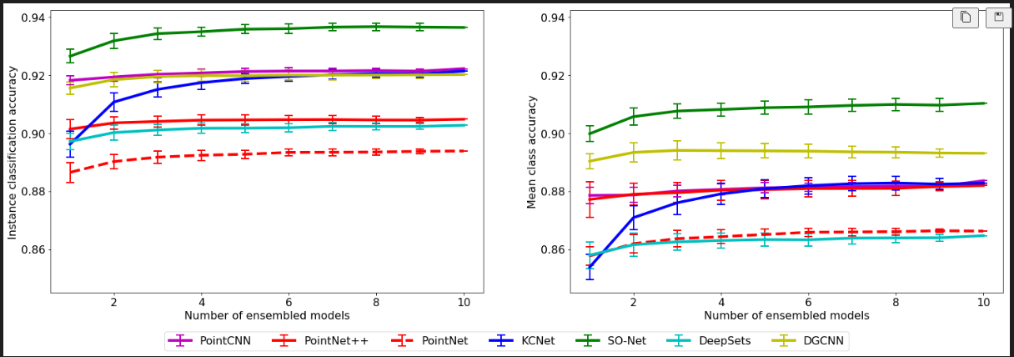
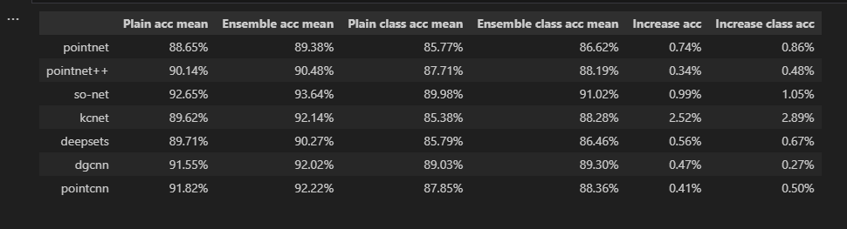
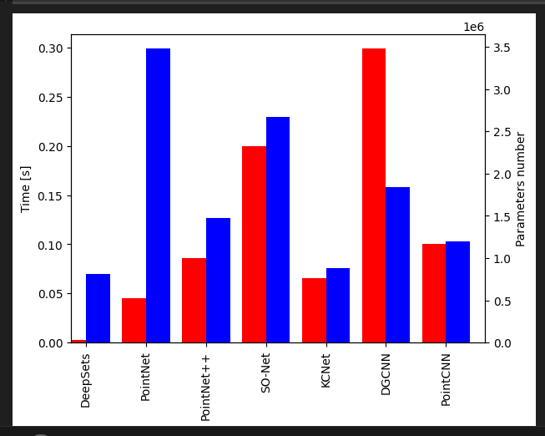
Challenges and Solutions
High Data Volume: Point clouds often involve millions of points, making real-time processing and memory usage challenging.
Model Complexity and Training Time
Challenge: Scaling these models for very large datasets or real-time applications
Large Ensembles:Challenge: Balancing ensemble size with computational feasibility.
Real- Time Processing Needs:
Applications like autonomous driving require low-latency performance, which is hard with complex models or ensembles.
Challenge: Balancing accuracy with speed.

Slide 11
Limitations
Irregular and Unstructured Nature
Noise and Outliers
High Data Volume
Point clouds lack consistent connectivity or regular structure, complicating tasks like surface reconstruction, feature extraction, and geometric processing.
Point clouds contain millions of points, requiring substantial storage and computational resources, posing challenges for real-time processing and scalability.
Point clouds often contain noise and outliers due to sensor inaccuracies or environmental factors, affecting data quality and processing.

Slide 12
Future Potential and Growth
Point cloud technology is poised for significant growth, with applications in construction, heritage preservation, automotive, robotics, and healthcare. Future trends include AI integration, real-time processing, and data fusion with other technologies, unlocking its full potential for innov

Slide 13
Conclusion
Point cloud technology is a transformative tool in fields like autonomous driving, robotics, architecture, and medical imaging, enabling accurate 3D spatial data representation. Despite challenges like irregularity, noise, and computational demands, advancements such as deep learning, graph-based techniques, and multi-scale feature extraction have enhanced processing efficiency and scalability. Applications include as-built models in construction, surgical planning in healthcare, and environmental perception for autonomous systems. Future research aims to address challenges in real-time processing, large-scale data handling, and AI integration, promising new innovations in 3D modeling and beyond.

